Slide 1
Donald Vu portfolio dallas, tx

Slide 2







ABOUT ME DATA ANALYST | SQL | PYTHON | TABLEAU
4+ years working with operations and business teams to deliver reporting, troubleshoot client issues, and support day-to-day data needs
Pivoting into healthcare analytics to make a meaningful impact
Experienced in data extraction (SQL), automation (Python), and reporting (Tableau)

Slide 3
PROJECTS OVERVIEW
Excel-Macro Automated Reporting Tool
Consumer Complaint
Dashboard
Healthcare Dashboard
Normalizes complaint volume across agencies and reveals service issues using contract KPIs
SQL
Tableau
Visualizes hospital readmission trends, length of stay, and diabetes impact using dummy patient data
SQL
Tableau
GCP
GIT
Automates data cleaning, validation, SQL job execution, and report generation with email notifications
Excel
SQL
Python

Slide 4
Excel-Macro Automated Reporting Tool – Overview
BUSINESS NEED: Standardize and automate exception reporting for operations
Built an Excel front-end for user-friendly navigation across reporting modules
Used Python to clean source files and validate formatting before processing
Automated BigQuery SQL execution for data extraction and SLA evaluation
Final output includes a clean Excel report with automated email delivery

Slide 5
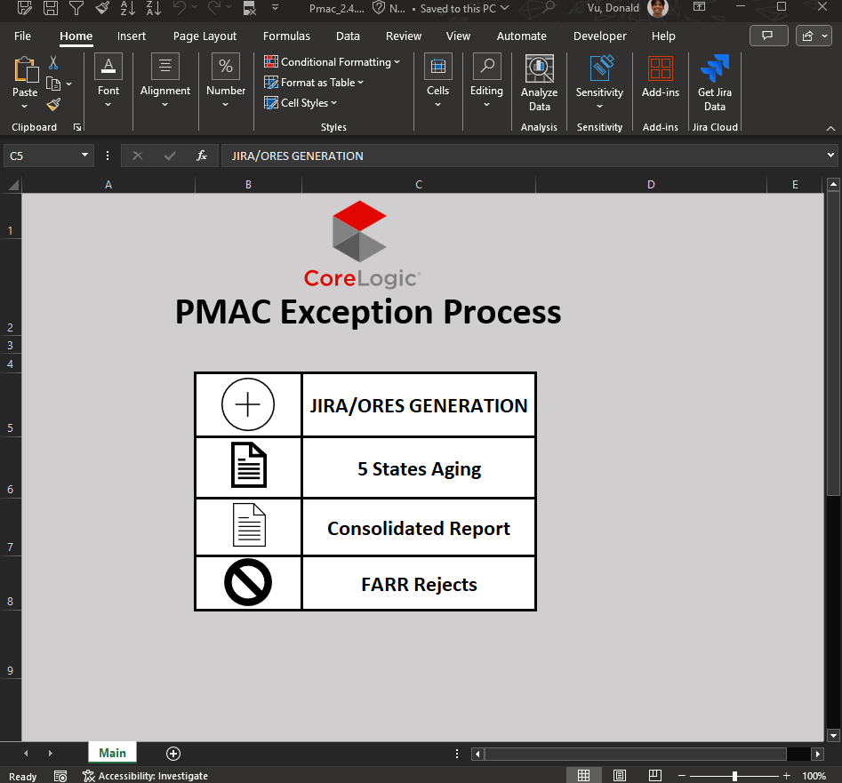
User interface & entry point
Custom Excel UI built to simplify tool access and workflows
Users start by selecting the reporting module (e.g., 5 States Aging, Consolidated Report)
Ensures ease of use without needing to touch any code or backend logic

Slide 6
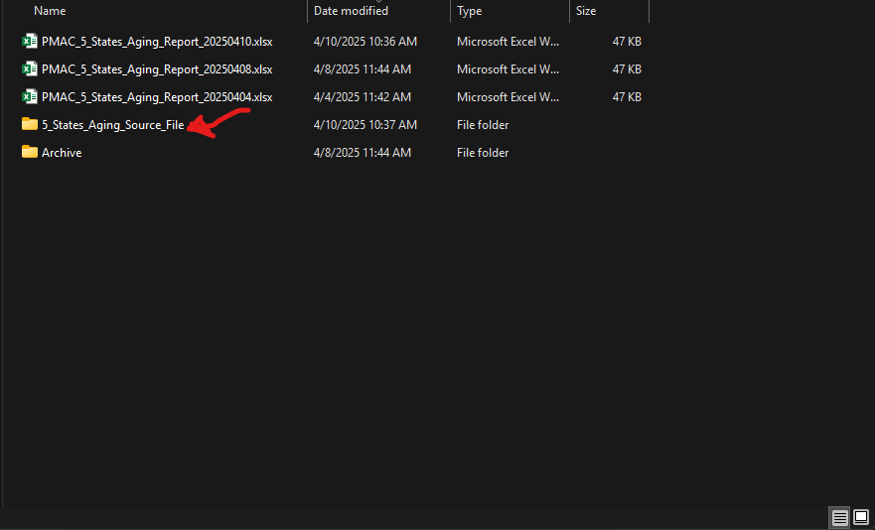
Automated File Sweep – 5 States Aging Report
This process is specific to the 5 States Aging module
User drops the source file into a designated folder
Folder is continuously monitored by a Python watchdog script
Once detected, the file is validated, cleaned, and staged for processing
Final report is generated and automatically emailed to a predefined distribution list
No manual cleanup, renaming, or emailing required

Slide 7
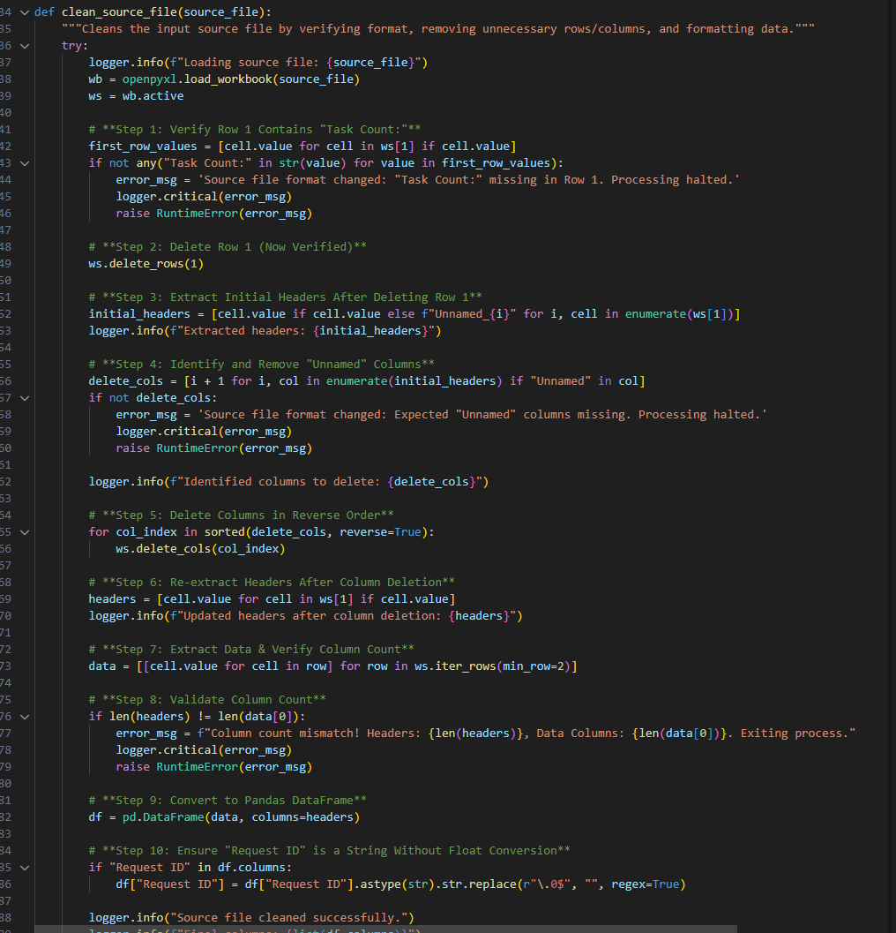
Python Script – File Validation & Cleanup
Script validates source file structure and content
Checks for required headers like “Task Count”
Automatically deletes empty rows and unnecessary columns
Reconstructs cleaned data into a pandas DataFrame
Verifies correct column count before continuing
Ensures "Request ID" is properly formatted (e.g., removing float conversion issues)

Slide 8
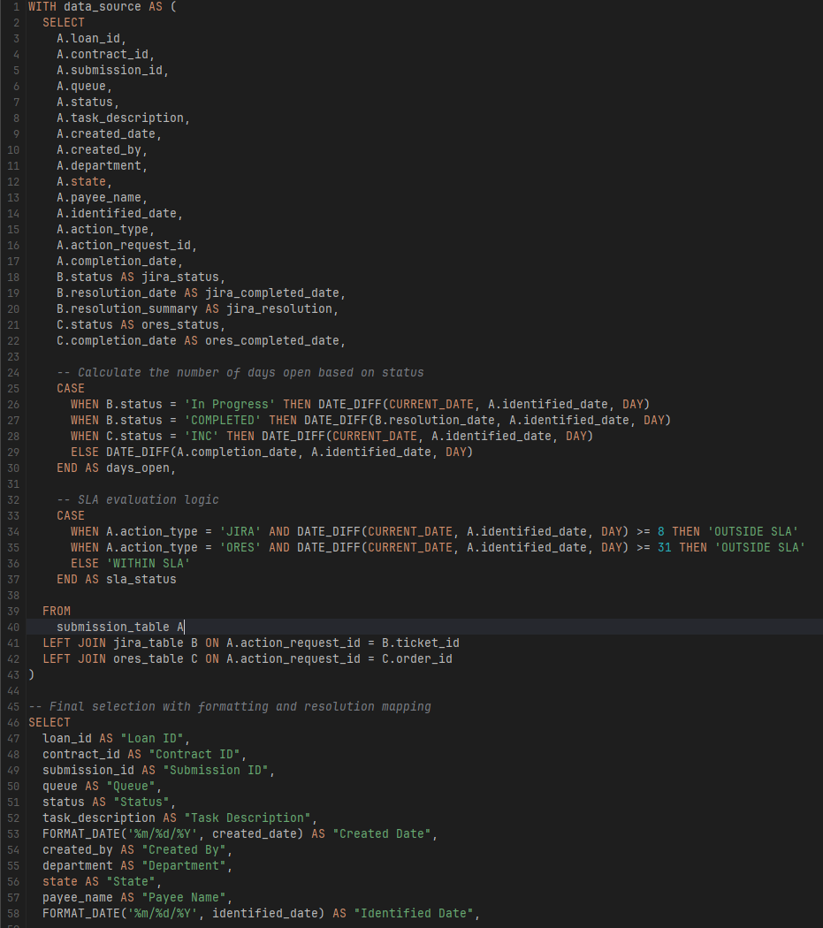
SQL Logic – SLA Classification (Part 1)(query has been redacted for confidentiality purposes)
Combined submission, Jira, and ORES data
Calculated “Days Open” using case logic”
Applied SLA threshold logic for Jira (8 days) and ORES (31 days)

Slide 9
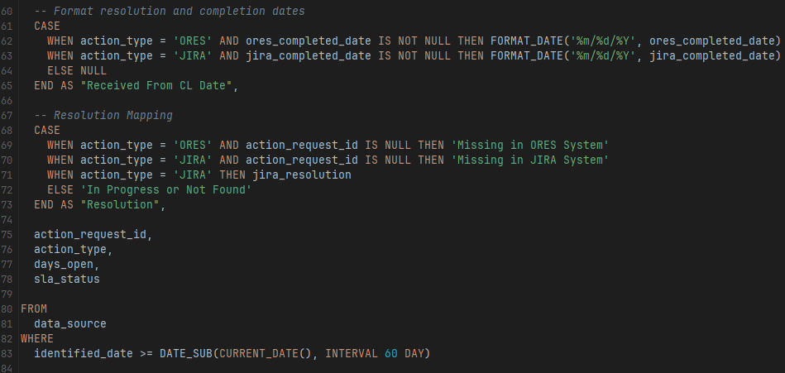
SQL Logic – SLA Classification (Part 2)(query has been redacted for confidentiality purposes)
Added formatting for key dates
Mapped resolution status
Applied 60-day filter to focus on recent submissions

Slide 10
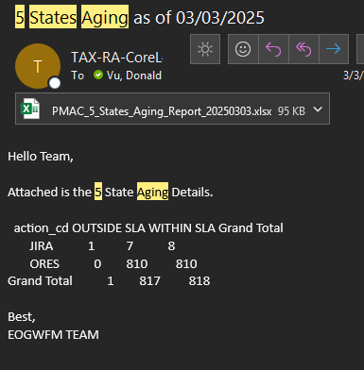
Report Generation & Automated Email Delivery
Final report is emailed automatically upon successful completion
Email includes timestamped file and is sent to a predefined client list
Built-in error handling sends alerts if issues occur during processing

Slide 11
Excel-Macro Automated Reporting Tool – Final TAKEAWAYS
Automated a manual reporting workflow end-to-end using Excel, Python, and SQL
Created a user-friendly tool that’s now used by operations teams with no coding required
Improved my skills in data cleaning, error handling, and cross-tool integration
Gained experience building logic for SLA tracking, report formatting, and automated email delivery
Reinforced my interest in building solutions that save time, reduce errors, and deliver reliable insights

Slide 12
Consumer complaint dashboard - overview
BUSINESS NEED: Break down complaints by agency and category to uncover problem patterns
Normalized complaint volume using total contract count for each agency
Built SQL logic in BigQuery to prep & join datasets
Created Tableau dashboard to visualize agency trends and complaint categories

Slide 13
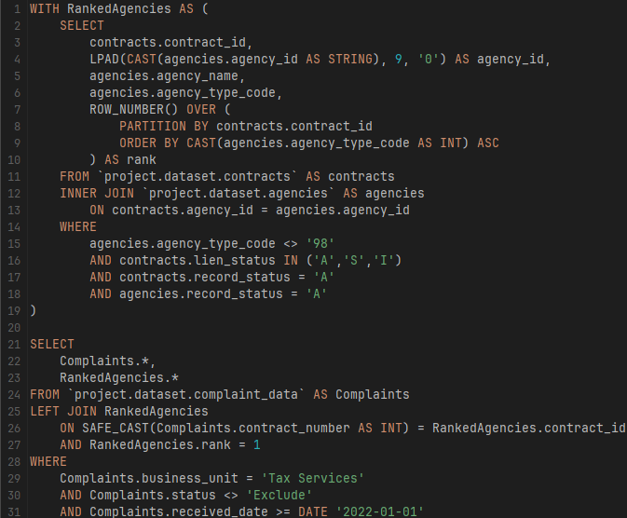
QUERY: AGENCY + COMPLAINT JOIN (query has been redacted for confidentiality purposes)
Joined complaint data with agency table
Used ROW_NUMBER() to get the primary agency per contract
Filtered out inactive and excluded rows
Prepared clean complaint records for dashboarding

Slide 14
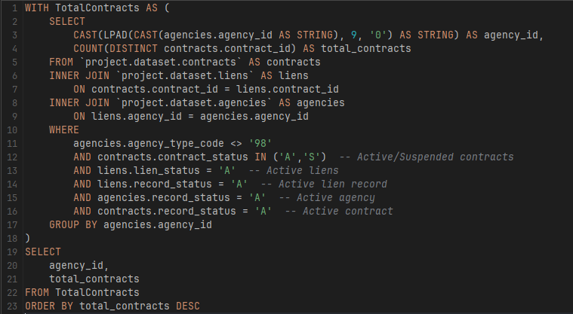
QUERY: TOTAL contract count (query has been redacted for confidentiality purposes)
Created a CTE to calculate total contracts per agency
Casted agency ids to a formatted string for consistency in joins
Filtered for active records

Slide 15
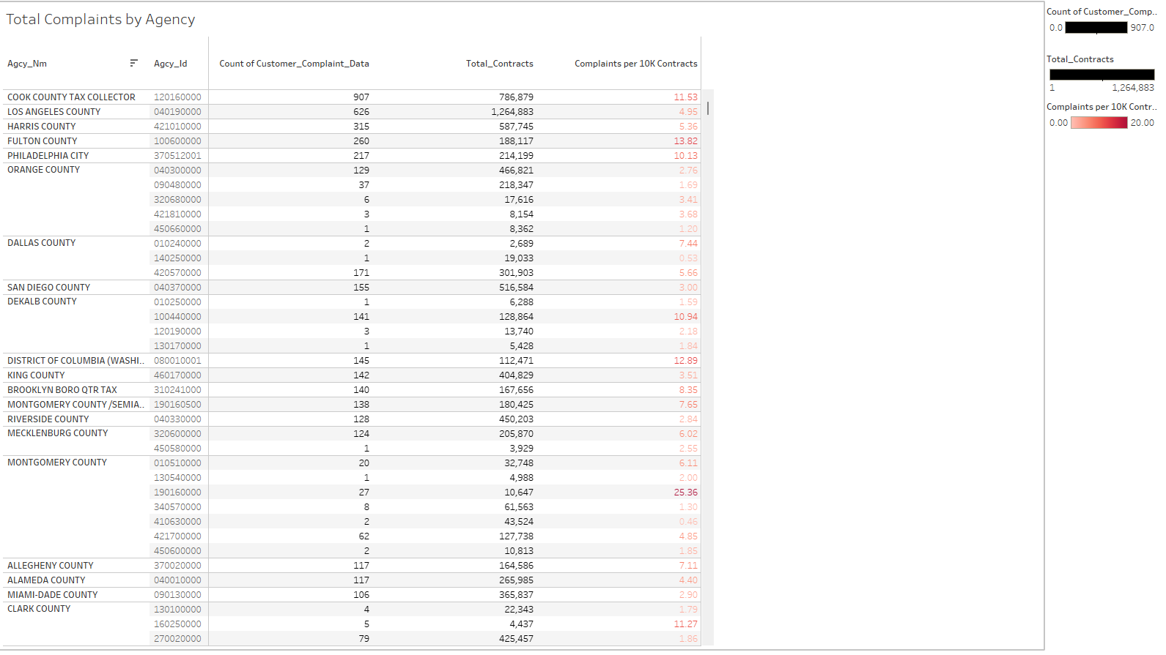
DASHBOARD: COMPLAINTS per 10k contracts
Created a calculated field in Tableau: Count(Complaints) / Total Contracts * 10,000 to normalize volume
Used this KPI to compare agency performance fairly, regardless of size
Applied color formatting to highlight agencies with elevated complaint rates
Helped stakeholders quickly identify outliers and prioritize improvements

Slide 16
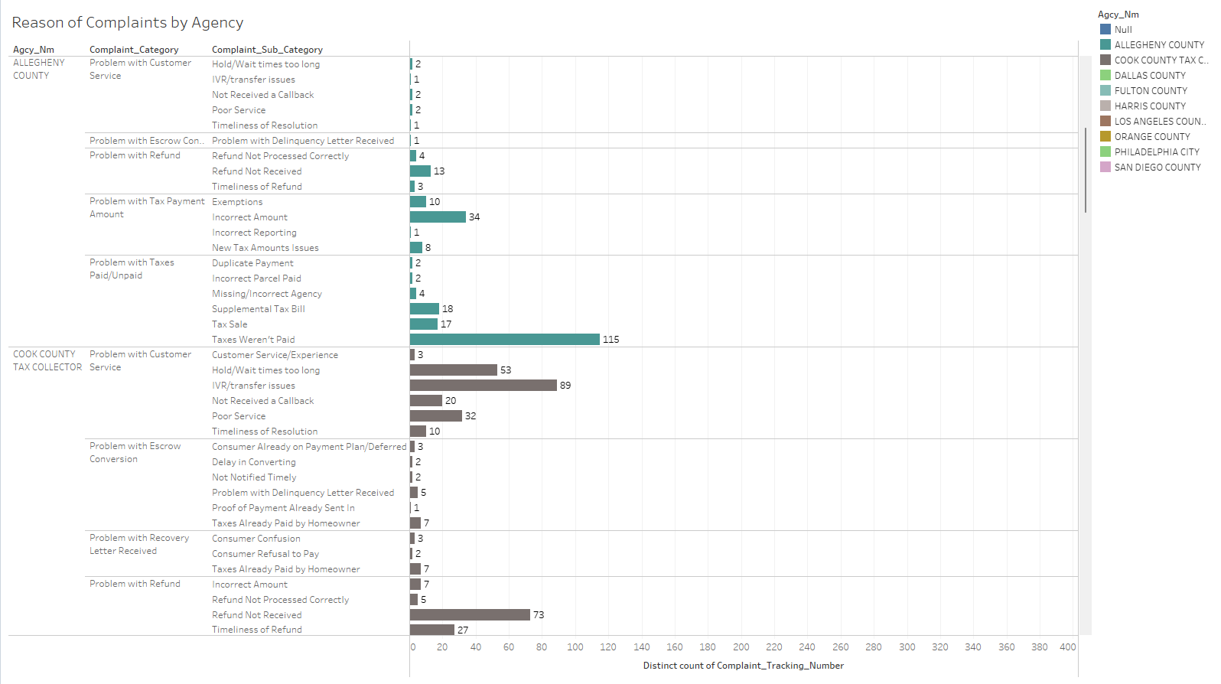
Dashboard: Complaint Reason Breakdown – top 10 agencies
Applied a Top 10 filter based on count of distinct Complaints
Focuses view on agencies with the highest number of unique complaints
Grouped by Complaint Category and Sub-Category to uncover key issue types
Helps stakeholders quickly spot and prioritize problem areas

Slide 17
CONSUMER COMPLAINT DASHBOARD – FINAL takeaways
Developed a KPI that adjusts complaint counts based on contract volume, allowing for fair comparison across agencies regardless of size
Enabled teams to identify service breakdowns by complaint category and agency
Improved SQL fluency through CTEs, joins, row-ranking, and data cleaning in BigQuery
Gained hands-on experience using Tableau to build layered, filterable dashboards
Reinforced my interest in using data to uncover operational issues and drive accountability

Slide 18
Healthcare dashboard - overview
BUSINESS NEED: Identify key drivers behind hospital readmissions using dummy patient data
Built Tableau dashboard to visualize readmission trends and enable data-driven decision-making
Focused on indicators like length of stay, A1C test results, and primary diagnoses
Added filters for age, diagnosis, and emergency visits to explore high-risk populations

Slide 19
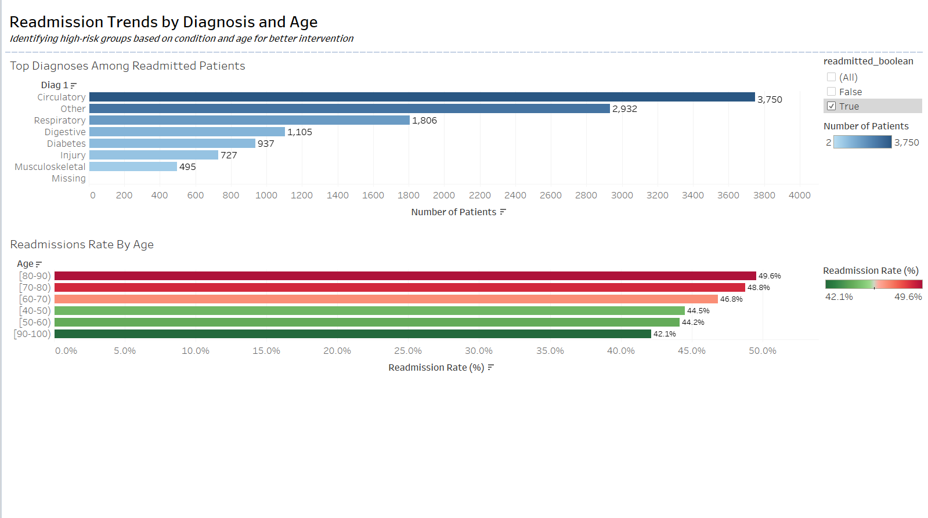
DASHBOARD: READMISSION TRENDS BY Diagnosis & age
Focused on readmitted patients only to analyze who’s returning to the hospital
Highlighted top diagnoses with the highest number of readmissions (e.g., Circulatory, Respiratory, Diabetes)
Identified older age groups (70–90) as having the highest readmission rates
Helps stakeholders prioritize high-risk groups for outreach and care improvements

Slide 20
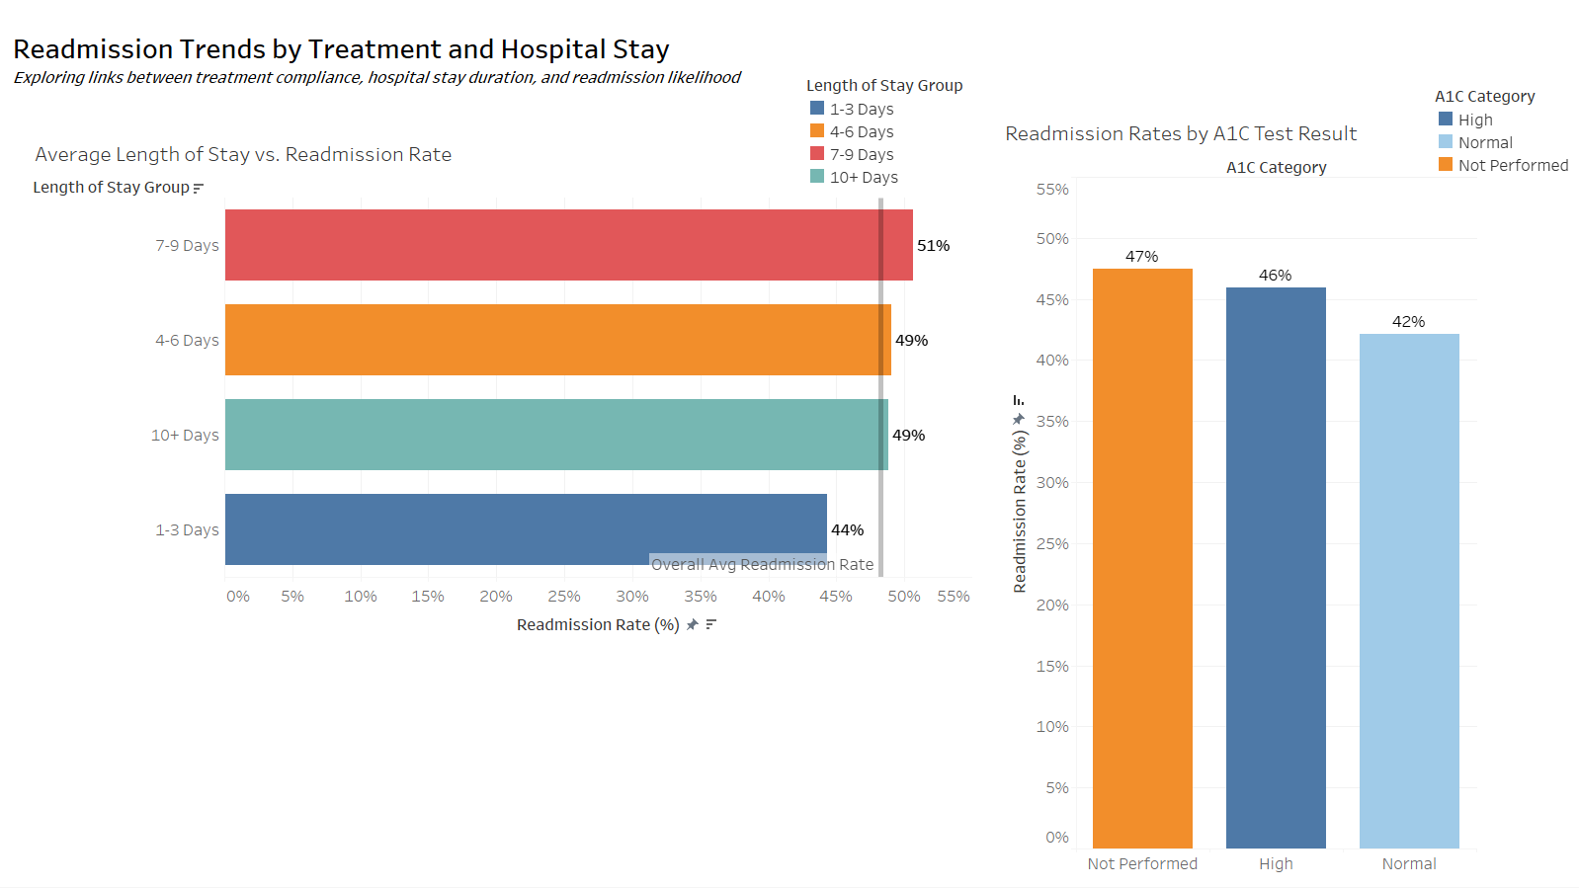
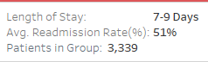
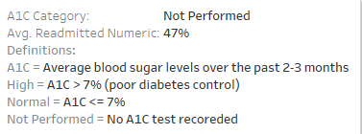
DASHBOARD: READMISSION TRENDS BY Treatment & hospital stay
Compared readmission rates by length of hospital stay
Patients who stayed 7–9 days had the highest readmission rate at 51%
Added a reference line to highlight the average across all stay durations
Analyzed A1C test results to evaluate diabetes management
Patients without A1C testing had the highest readmission rate (47%), which may point to a treatment gap in diabetes management.”

Slide 21
Healthcare DASHBOARD – FINAL takeaways
Learned how to break down large datasets into focused questions tied to real-world problems (like hospital readmissions)
Practiced using SQL to explore patterns in patient data
Got more comfortable designing visuals with intent — each chart answers a specific part of the story
Realized how important it is to normalize KPIs (like complaint rates or readmission rates) to make fair comparisons
Built confidence presenting technical work in a way that’s clear to non-technical audiences

Slide 22
TECHNICAL STRENGTHS OF WHAT I BRING TO THE TABLE
SQL – CTEs, joins, filtering logic, KPI Calculations
GCP/BigQuery - Used cloud-based SQL querying to analyze healthcare data, and connected to DBVisualizer for easier local exploration
PYTHON – Data Cleaning (pandas), Excel file automation
TABLEAU – Trend Analysis, KPI Dashboards
EXCEL/VBA – Automated pipelines, report generated macros
GIT - Used Git to version-control and publish my portfolio projects to GitHub for sharing and presentation
SOFT SKILLS – Strong communicator, problem solver

Slide 23
CONTACT INFO:
Donald Vu | Data Analyst
(682)256-9869
donaldhdvu@gmail.com
www.linkedin.com/in/donaldvu
www.github.com/donnieevu

